Slide 1

Flutter

Slide 2
Flutter
Container
Row
Column

Slide 3
Container Widget

Slide 4
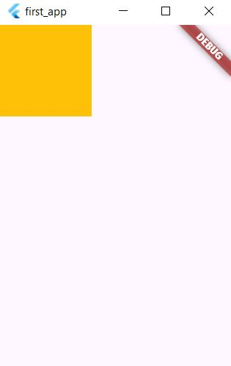
Container Widget
Container(
height: 100,
width: 100,
color: Colors.amber,
),

Slide 5
Container Widget
Container(
height: 100,
width: 100,
decoration: BoxDecoration(
color: Colors.amber,
),
),

Slide 6
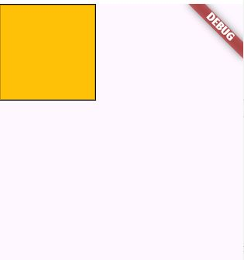
Container Widget
Container(
height: 100,
width: 100,
decoration: BoxDecoration(
color: Colors.amber,
border: Border.all()
),
),

Slide 7
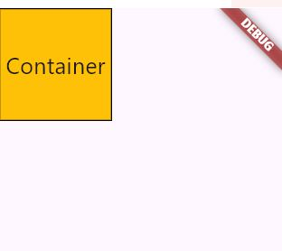
Container Widget
Container(
height: 100,
width: 100,
decoration: BoxDecoration(
color: Colors.amber,
border: Border.all()
),
child: Center(
child: Text('Container',style: TextStyle(fontSize: 20)
)
,),
),
);

Slide 8

Container Widget
Center(
child: Container(
height: 300,
width: 300,
color: Colors.red,
),
)

Slide 9
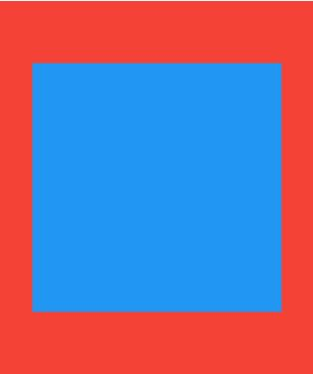
Container Widget
Center(
child: Container(
height: 300,
width: 300,
color: Colors.red,
child: Center(
child: Container(height: 200,width: 200,
color: Colors.blue,
),
),
),
)

Slide 10
Column Widget

Slide 11
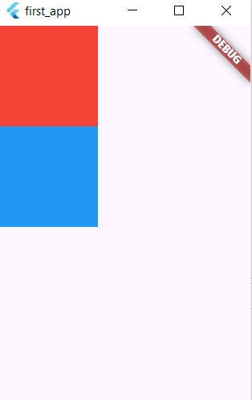
Column Widget
Column(
children:
[
Container(height: 100,width: 100,color: Colors.red,),
Container(height: 100,width: 100,color: Colors.blue,),
],
)

Slide 12
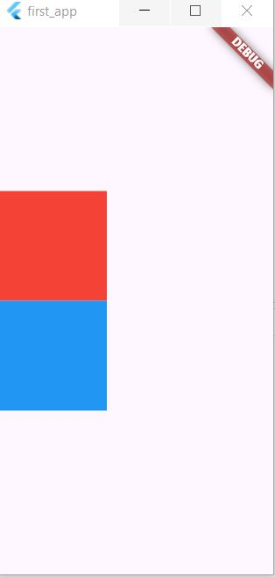
Column Widget
Column(
mainAxisAlignment: MainAxisAlignment.center,
children:
[
Container(height: 100,width: 100,color: Colors.red,),
Container(height: 100,width: 100,color: Colors.blue,),
],
)

Slide 13
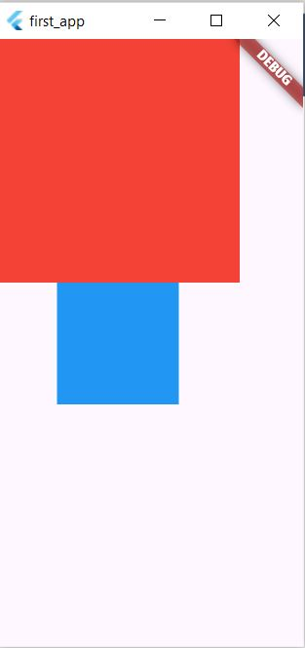
Column Widget
Column(
children:
[
Container(height: 200,width: 200,color: Colors.red,),
Container(height: 100,width: 100,color: Colors.blue,),
],
)

Slide 14
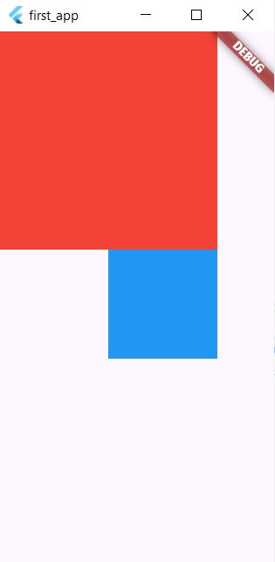
Column Widget
Column(
crossAxisAlignment: CrossAxisAlignment.end,
children:
[
Container(height: 200,width: 200,color: Colors.red,),
Container(height: 100,width: 100,color: Colors.blue,),
],
)

Slide 15
Row Widget

Slide 16
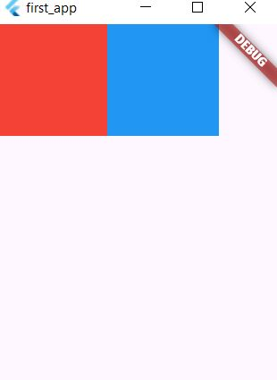
Row Widget
Row(
children:
[
Container(height: 100,width: 100,color: Colors.red,),
Container(height: 100,width: 100,color: Colors.blue,),
],
)

Slide 17
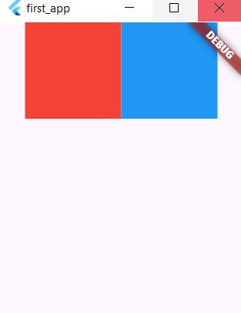
Row Widget
Row(
mainAxisAlignment: MainAxisAlignment.center,
children:
[
Container(height: 100,width: 100,color: Colors.red,),
Container(height: 100,width: 100,color: Colors.blue,),
],
)

Slide 18
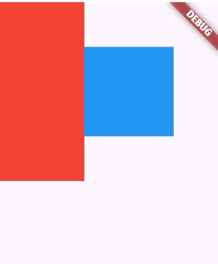
Row Widget
Row(
children: [
Container(height: 200,width: 100,color: Colors.red,),
Container(height: 100,width: 100,color: Colors.blue,),
],
)

Slide 19
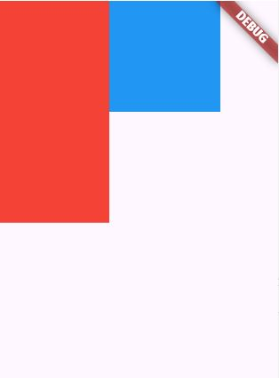
Row Widget
Row(
crossAxisAlignment: CrossAxisAlignment.start,
children: [
Container(height: 200,width: 100,color: Colors.red,),
Container(height: 100,width: 100,color: Colors.blue,),
],
)

